Slide 1
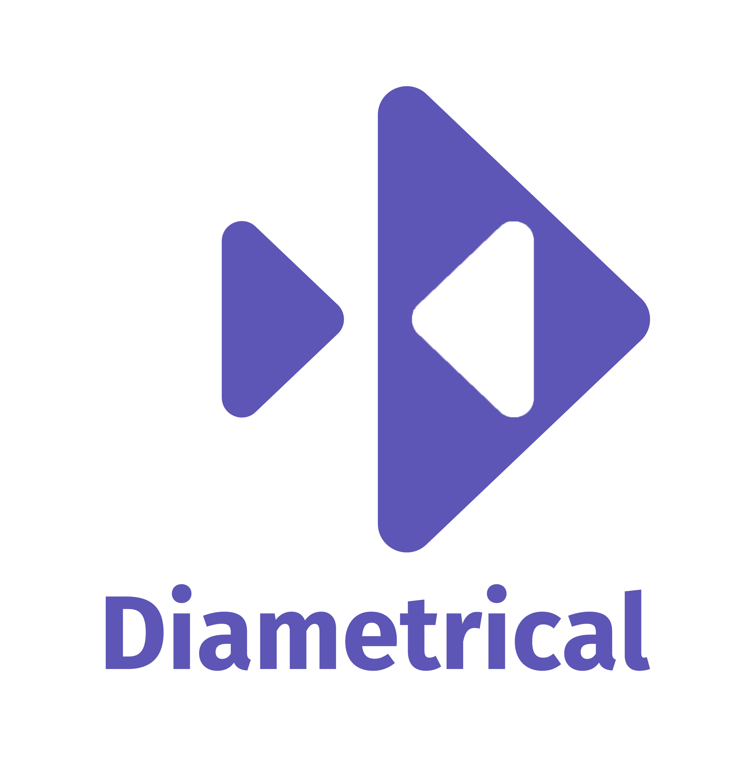
Over-complicating a toy problem with SAFE Stack and Akka.NET
Andrew J. Willshire

Slide 2
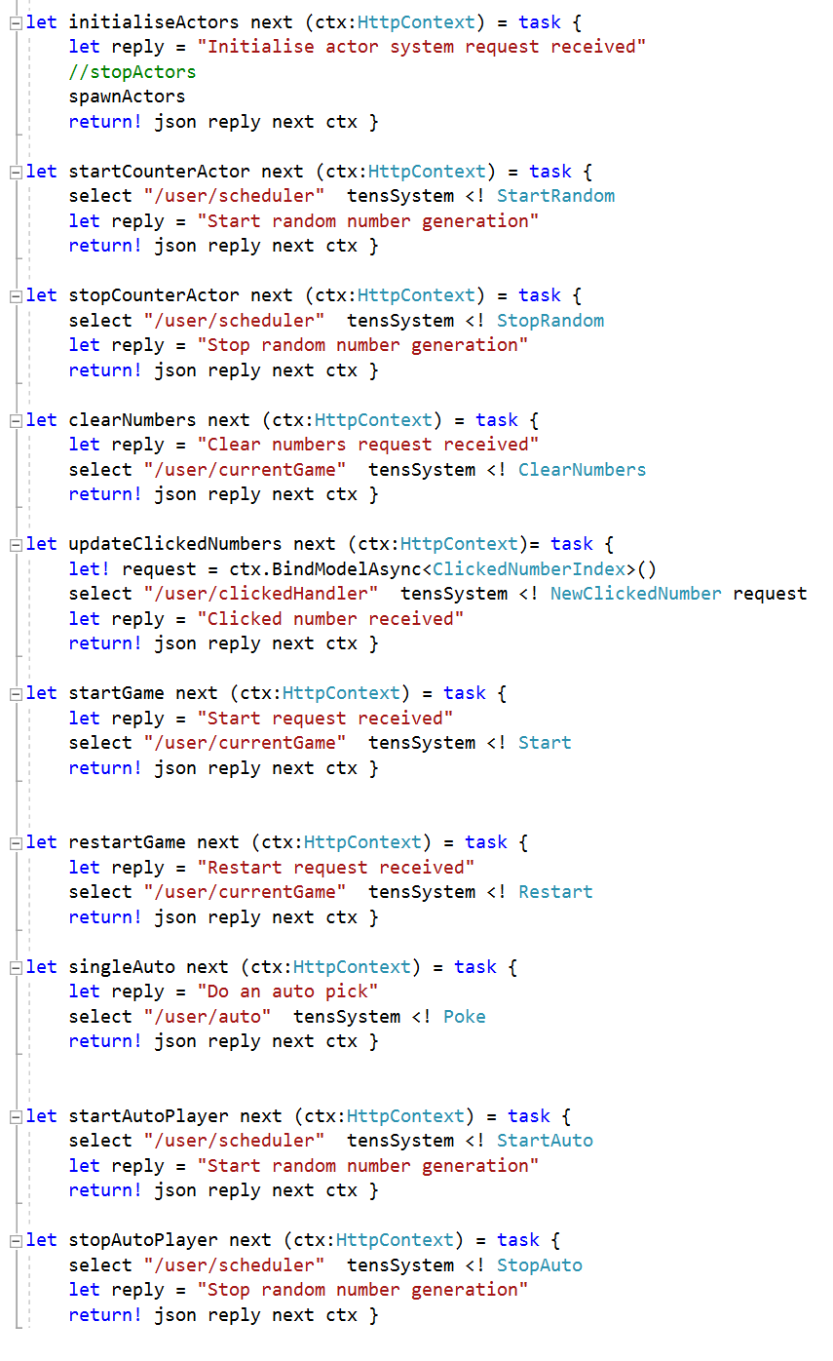
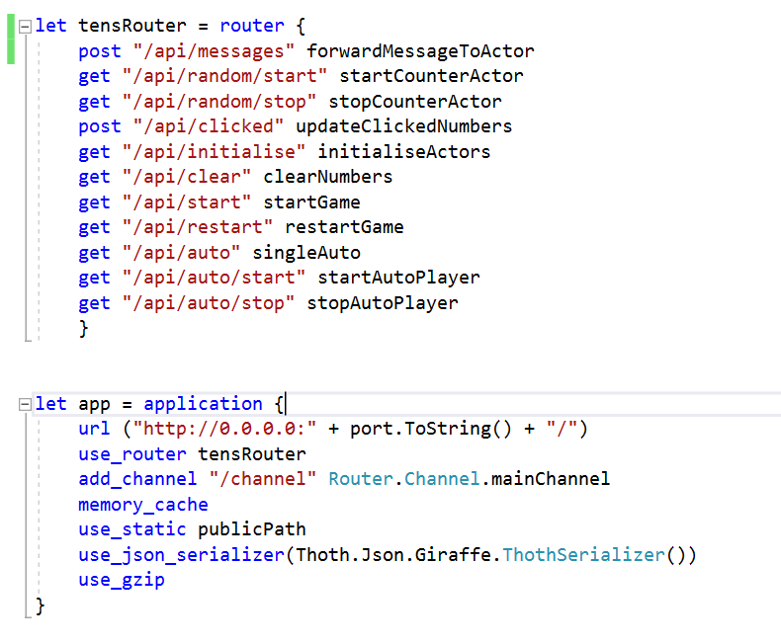

Slide 3
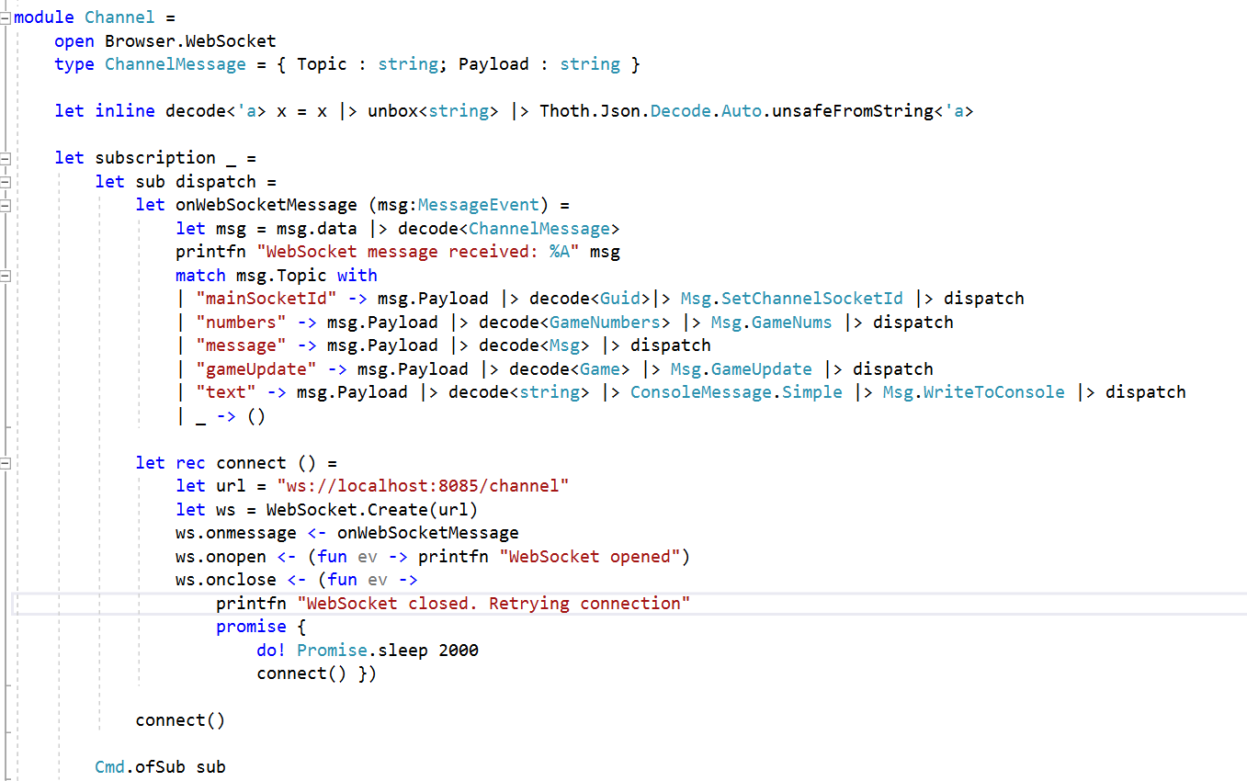

Slide 4
About Me
I am primarily an engineer / analyst (studied electrical engineering)
And then an applied mathematician (to a small extent within certain fields)
And then a programmer (for certain applications)
And then a physicist (I’m really, really not a physicist)
The way I have chosen to program this implementation reflects this
As does my ability to answer any particular questions
The implementation is designed for (my) understanding rather than performance

Slide 5
Thank you
https://github.com/ajwillshire/FSharpGA/
andrew@diametrical.co.uk
@ajwillshire

